Slide 1
WiFi
Version 3

Slide 2
Overview
Protocols
WiFi & OSI Layers
Antenas
Propagation
Access Methods
Security concerns
Security techniques
WEP
WPA/WPA2

Slide 3
802.11
Standard | Freq Range | Bandwidth | Geo-Range
802.11b | 2.4GHz | 11Mbps | 100 m
802.11a | 5 GHz | 54 Mbps | 50 m
802.11g | 2.4 GHz | 54 Mbps | 100 M
802.11n | 2.4 or 5.0 GHz | 600 Mbps | Indoor: 70 m Outdoor: 250 m
802.11ac (Wave 1) | 5 GHz - 3 data streams | 1.3 Gbps | Indoor: 70 m Outdoor: 250 m
802.11ac (Wave 2) | 5 GHz - 4 data streams | 3.47 Gbps | Indoor: 70 m Outdoor: 250 m
802.11ac (Wave 3) | 5 GHz - 8 data streams | 6.93 Gbps | Indoor: 70 m Outdoor: 250 m
Ref: West, Andrews, Dean. Network + Guide to Networks, p. 323

Slide 4
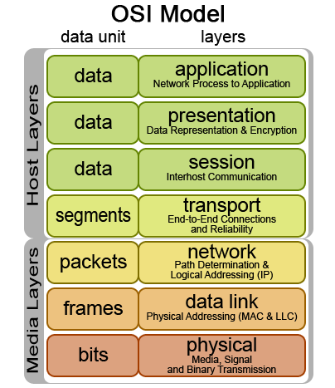
WiFi and OSI Layers
WiFi Similar to Wired
WiFi different

Slide 5
WiFi - Layer 1 - The Physical layer
At this layer the transceiver is controlled to access the medium
Unlike a bounded, wired medium, WLANs operate "over the air" and are subject to an entirely different set of rules for accessing and controlling the medium

Slide 6
WiFi - Layer 1 - The Physical layer
Wired networks can detect and mitigate data collisions
wireless networks cannot detect collisions
protocols allow access and control of the medium and to avoid collisions

Slide 7
WiFi - Layer 1 - The Physical layer
Wireless networks experience external interference and disruptions

Slide 8
WiFi - Layer 1 - The Physical layer
Wireless networks do not require physical access (to some degree)
Only need to be within range of an access point
Wireless presents significant operational and security challenges at Layer 1

Slide 9
WiFi - Layer 1 - The Physical layer
Frequency Band (2.4 or 5GHz)
Bandwidth 20/40/60/80/160Mhz)
Modulation Types: DSSS, FHSS, OFDM, BPSK, QAM, QPSK, etc

Slide 10
WiFi – Layer 2 - DataLink
Two sublayers: the Logical Link Control (LLC) sublayer and the Medium Access Control (MAC) sublayer
The LLC receives an IP packet from the Network layer above it and encapsulates the data with addressing and control information
This packet, now called a frame, is passed to the MAC, which modifies the addressing and control information in the frame header to ensure the data is in the proper form for application to the Physical layer
The MAC then passes the frame to the PHY, which modulates the data according to the PHY standard in use (DSSS, OFDM), and transmits the bits as RF
The process is reversed at the receiving end.
WiFi includes things on the data layer that are considered to be on different layers on the OSI stack (such as encryption), but are not considered at all on the TCP/IP stack

Slide 11
Antennas
Unidirectional – also called a directional antenna
Point-to-Point Link
Omni-directional – Sends (and receives) signals at same strength in all directions.
Highly mobile
Send/receive to/from many

Slide 12
Propagation
The way in which a signal travels
LOS – Straight line TX to RX
Degradations
Fading – Obstacles or barriers
Attenuation - Distance
Interference – From electromagnetic waves (EMI)
Refraction (into/through a different transmission medium that changes the wavelength, speed, or other characteristic (e.g., Water)
Reflection (obstacle or bounce back)

Slide 13
WiFi - Access Methods
CSMA/CA
Carrier Sense, Multiple Access/Collision Avoidance
Minimizes occurrence but can’t detect if collision occurs
Ref: West, Andrews, Dean. Network + Guide to Networks, p. 326

Slide 14
CSMA/CD Access Method
For Review: Wired Network
Brief Pause
Yes
Send Msg
Activity
Check for Transmissions
No
Brief Pause
Yes
Collision?
No
TX Complete
Notes:
Step 1: If no TX in progress, wait
if traffic, wait a brief period, and then check again
Step 2: Dest Receives, verifies accuracy, and then send ACK
If no ACK, then try resend

Slide 15
Hidden Node
Why WiFi uses a different Access Method

Slide 16
CSMA/CA Access Method
Send RTS
Activity
Check for Transmissions
No
Cleared
To
Send?
Yes
Yes
Send Msg
Brief Pause
No
TX Complete
Adapted from: West, Andrews, Dean. Network + Guide to Networks, p. 327

Slide 17
Hidden Node Problem
This is why Request to Send is needed
RTS/CTS used to solve this problem
Client
Access
Point
Client
Distance too great to see each others transmission

Slide 18
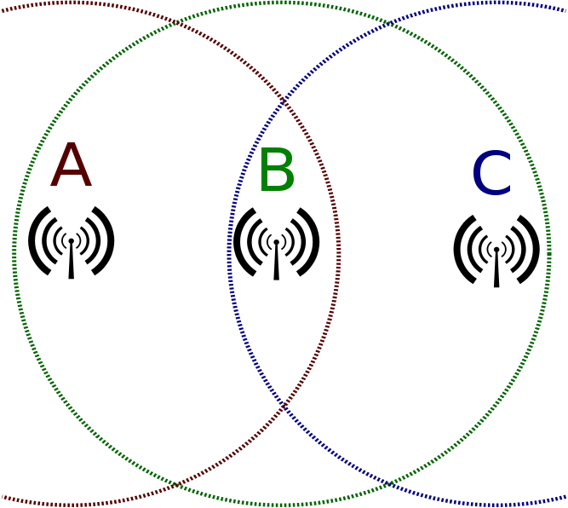
Hidden Node Problem
This is why Request to Send is needed
Different View
C = TX Range
A = TX Range
B = AP Range
https://upload.wikimedia.org/wikipedia/commons/2/2b/Wifi_hidden_station_problem.svg

Slide 19
Solve Hidden Node → RTS/CTS
A.k.a. CSMA/CA

Slide 20
Channels
Channels help with traffic congestion and interference

Slide 21
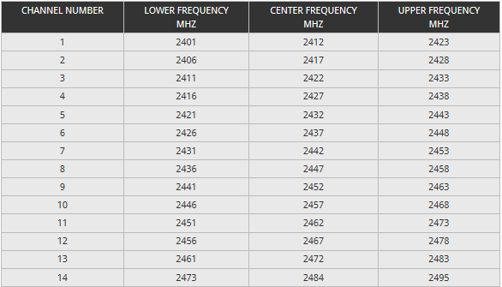
2.4 GHz Channels

Slide 22
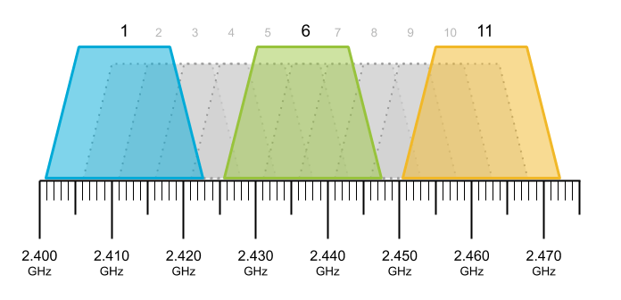
Channels 2.4 GHz
Lots of channels, but only 3 distinct separations
1, 6, 11,

Slide 23
5 Ghz Channels
Channel Planning Best Practices for Better Wi-Fi - Ekahau
Available channels on the 5 GHz Wireless network – Keenetic
Wi-Fi Channels, Frequency Bands & Bandwidth » Electronics Notes (electronics-notes.com)

Slide 24
Heat Maps

Slide 25
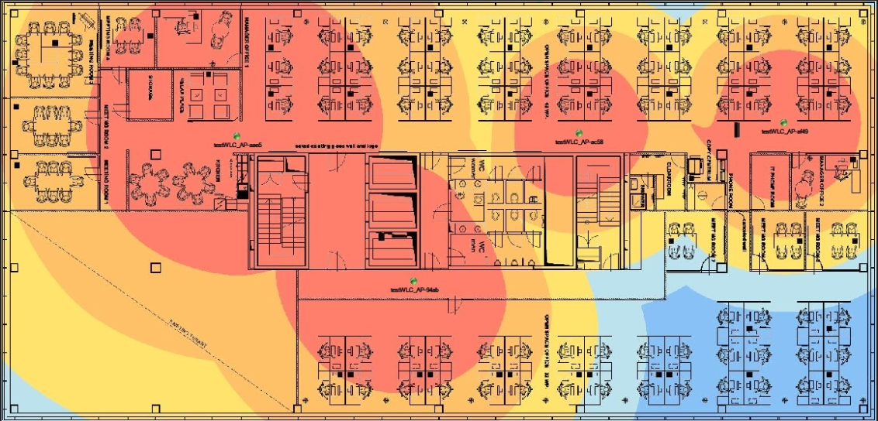
Heat Maps

Slide 26
Security

Slide 27
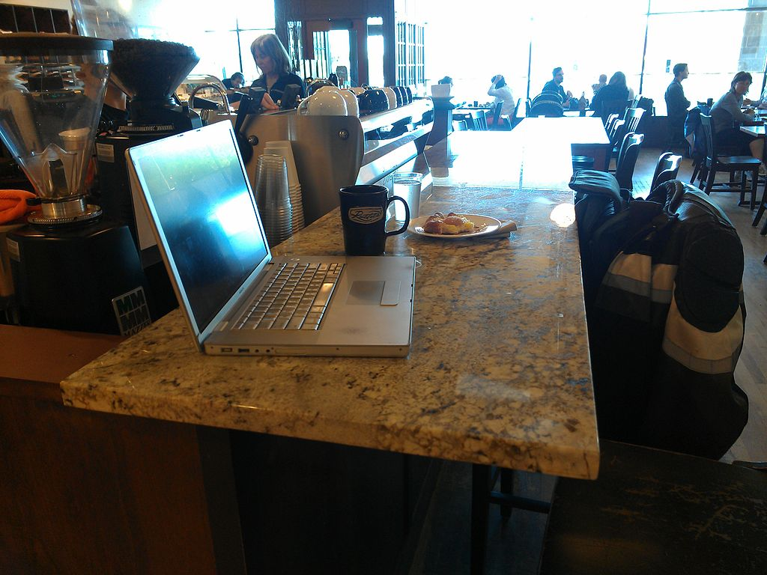
While at the coffee shop, your PC is constantly scanning for and talking to access points.
(Think Evil Twin)
SRC: https://commons.wikimedia.org/wiki/File:Andrew_Bogott%27s_occasional_workspace.jpg

Slide 28
Security Requirements
Security between two network entities should provide the following
Authentication
Integrity
Privacy
Primarily eavesdropping attempts

Slide 29
WiFi Threats
Man-in-the-middle attacks
(Most Common)
Rogue access points
Denial of service
Other threats include:
Ad hoc networks
MAC Spoofing
Network Injection

Slide 30
Additional WiFi Threats
War Driving
War Chalking (symbols)
WPA Attacks (cracking keys)
WPS Attacks (Auto setup)
Evil Twins
https://www.safervpn.com/blog/10-public-wi-fi-security-threats/
Notes:
Evil Twin – same as rogue access point and leads to man in the middle attacks

Slide 31
Man-In-The-Middle Attacks
Attacker intercepts messages in a public key exchange and retransmits them.
Attacker substitutes his own public key for the requested one.
Original parties believe they are just communicating with each other
The attacker has access to both user’s messages
Notes:
-Form of eavesdropping

Slide 32
Typical Man-In-The-Middle Attack
Bad guy gets in the middle
Keeps keys and replaces with his own key
Bob
Bob’s Key
Bad
Guy
Bob’s Key
Alice
Bad guy keeps Alice’s key
Send own key to Bob
Alice sends Key
Bad guy sends
His account #
Bob send account #
Alice sends $$$ to
Bad guy’s account

Slide 33
WiFi

Slide 34
Man-In-The-Middle Attacks (cont.)
Pineapple Joins the
Access point
Bob
Access
Point
Pineapple sends all traffic back from AP
But gets to look at all traffic

Slide 35
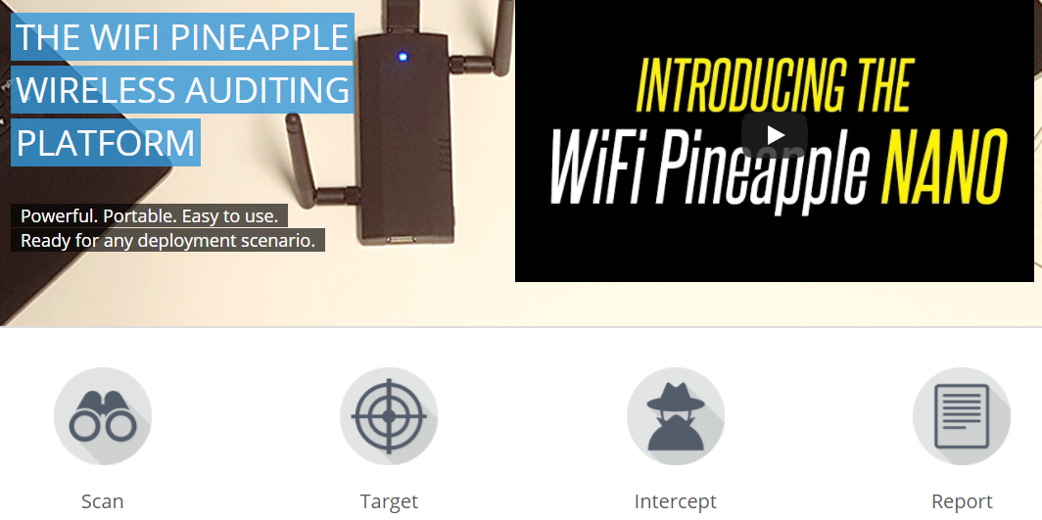
Pineapple

Slide 36
Denial of Service
An attempt to make a machine or network unavailable
Many different methods of attacks
Internet Control Message Protocol Flood
SYN flood
Teardrop attacks
Notes:
-Attacks usually overload the server
-Causes the victim to no longer communicate adequately

Slide 37
DoS: ICMP Flood (SMURF Attack)
Distributed DoS attack in which large numbers of ICMP packets with the intended victim's spoofed source IP are broadcast to a computer network using an IP Broadcast address.
Devices on the network respond to the ICMP with a reply to the source IP address.
Think back to how CSMA/CA works, and note how sensitive WiFi is to DoS

Slide 38
Rogue Access Points
A wireless access point on a company network without authorization
Often used to conduct a man-in-the-middle attack
To combat rogue WLANs
Use a wireless scanner
Wireless intrusion detection/prevention system (IDS/IPS)
Harden/Secure the network

Slide 39
WiFi Security
WEP, WPA, WPA Enterprise

Slide 40
Wireless Network Security Methods
WEP – Wired Equivalent Privacy
WPA- Wi-Fi Protected Access
WPA2/802.11i

Slide 41
Wired Equivalent Privacy (WEP)
Original encryption protocol
IEEE 802.11 wireless LANs
Same level of security as wired networks
No longer recommended
Easily cracked in seconds by sniffing encrypted traffic
Notes:
-Easily Hacked

Slide 42
Wi-Fi Protected Access (WPA)
Replaces WEP
Stronger encryption (but still weak)
Standard Encryption technology
TKIP – Temporal Key Integrity Protocol

Slide 43
Wi-Fi Protected Access 2 (WPA2)
Replaced WPA on all Wi-Fi hardware since 2006
Government grade security by combining the AES encryption algorithm and 802.1x-based authentication
Two versions
Enterprise – Server authentication 802.1x
Personal – AES pre-shared key
Backward compatible with WPA
Uses CCMP

Slide 44
WPA2 Personal vs WPA2
Personal
Uses pre-shared key to optimize its effectiveness without an authentication server
Used in small office and home environments
Enterprise
Caters to big businesses
Uses open system authentication in its first phase and the Extensible Authentication protocol method and 802.1x protocol in its second phase

Slide 45
WPA2 Authentication
IEEE 802.1x
WPA2 personal doesn’t require an authentication server
WPA2 enterprise consists of the following:
Client
Access Point
Authentication Server

Slide 46
Why use WPA2?
WPA2 defends against
Man-in-the-middle attacks
Weak Keys
Packet forging
Brute-force attacks

Slide 47
WPA2 flaws
Can’t withstand a physical layer attack such as:
Data flooding
Access point failure
Vulnerable to a DoS attack

Slide 48
WPA 3?
January 2018 -- Wi-Fi Alliance announces WPA3 as a replacement to WPA2
Uses 192-bit encryption and individualized encryption for each user
The Wi-Fi Alliance also claims that WPA3 will mitigate security issues posed by weak passwords and simplify the process of setting up devices with no display interface
https://en.wikipedia.org/wiki/Wi-Fi_Protected_Access

Slide 49
Summary
Protocols
WiFi & OSI Layers
Antenas
Propagation
Access Methods
Security concerns
Security techniques
WEP
WPA/WPA2

Slide 50
?

